Slide 1
Normalization
Lecture - 07

Slide 2
Learning Outcome
LO3: Apply formal methods to refine the data model

Slide 3
Database Design process
1.Requirements Analysis
What does the user want?
2.Conceptual Database Design
Defining the entities and attributes, and the relationships between these --> The ER model
3.Logical Database Design (Map ER to Relational Schema)
4.Schema Refinement (fine tune )
5.Physical Database Design
Implementation of the design using a Database Management System
6.Security Design
Implement Controls to ensure security and integrity

Slide 4
Normalization
Conceptual Modeling is a subjective process
Therefore, the schema after the logical database design phase may not be very good (contain redundant data)
However, there are formalisms to ensure that the schema is good.
This process is called Normalization

Slide 5
Normalization
Relational database schema = set of relations
Relation = set of attributes
How we group the attributes to relations is very important
Normalization or Schema Refinement help determine “GOOD” relations

Slide 6
Purpose of Normalization
To avoid redundancy by storing each ‘fact’ within the database only once.
To put data into a form that conforms to relational principles (e.g., single valued attributes, each relation represents one entity) - no repeating groups.
To put the data into a form that is more able to accurately accommodate change.
To avoid certain updating ‘anomalies’.
To facilitate the enforcement of intergrity constraints.

Slide 7
Redundancy and Data Anomalies
Redundant data is where we have stored the same ‘information’ more than once. i.e., the redundant data could be removed without the loss of information.
Example: We have the following relation that contains staff and department details:
staffNo | job | dept | dname | city
SL10 | Salesman | 10 | Sales | Stratford
SA51 | Manager | 20 | Accounts | Barking
DS40 | Clerk | 20 | Accounts | Barking
OS45 | Clerk | 30 | Operations | Barking

Slide 8
staffNo | job | dept | dname | city
SL10 | Salesman | 10 | Sales | Stratford
SA51 | Manager | 20 | Accounts | Barking
DS40 | Clerk | 20 | Accounts | Barking
OS45 | Clerk | 30 | Operations | Barking
Such ‘redundancy’ could lead
to the following ‘anomalies’
Insert Anomaly: We can’t add a new a dept without inserting a member of staff that works in that department
Update Anomaly: Change the name of the Accounts dept to Finance dept. We have to change all other records to avoid update anomaly.
Deletion Anomaly: Employee SL10 resigns. We remove the record. With that we lose all information pertaining to the Sales dept.

Slide 9
Repeating Groups
Is an attribute (or set of attributes) that can have more than one value
staffNo | job | dept | dname | city | contact number
SL10 | Salesman | 10 | Sales | Stratford | 018111777, 018111888, 079311122
SA51 | Manager | 20 | Accounts | Barking | 017111777
DS40 | Clerk | 20 | Accounts | Barking
OS45 | Clerk | 30 | Operations | Barking | 079311555
Repeating Groups are not allowed in a relational design, since all attributes have to be ‘atomic’ - i.e., there can only be one value per cell in a table!

Slide 10
Schema Refinement
A relation with redundancy can be refined by
Decomposing the relation into smaller relations…
contain the same information
with no redundancy

Slide 11
Problems related to decompositions
What problems (if any) does a given decomposition cause?
To help:
Two properties of decompositions:
Loss-less join property
Dependency preserving property
Normal forms have been proposed to preserve above properties.

Slide 12
Loss-less join property
Loss-less join property: we might lose information if we decompose relations…
S
R₁
R₂
S | P | D
S1 | P1 | D1
S2 | P2 | D2
S3 | P1 | D3
S | P
S1 | P1
S2 | P2
S3 | P1
P | D
P1 | D1
P2 | D2
P1 | D3

Slide 13
Loss-less join property (contd.)
Joining them together, we get spurious tuples…
R₁ R₂
S | P | D
S1 | P1 | D1
S1 | P1 | D3
S2 | P2 | D2
S3 | P1 | D1
S3 | P1 | D3

Slide 14
Dependency-preserving property
Consider previous example
Dependency-preserving property: The set of dependencies in relation S can be verified by a set of dependencies in relation R₁ and relation R₂
R₁
R₂
S
S | P | D
S1 | P1 | D1
S2 | P2 | D2
S3 | P1 | D3
S | P
S1 | P1
S2 | P2
S3 | P1
P | D
P1 | D1
P2 | D2
P1 | D3

Slide 15
Informal Guidelines
Guideline 1 : The relation’s semantics should be clear and easy to explain.
Attributes of different entities (EMPLOYEEs, DEPARTMENTs, PROJECTs) should not be mixed in the same relation
Only foreign keys should be used to refer to other entities
Do not combine attributes from multiple entity types and relationship types in to a single relation
Notes:
Semantics: Real world meaning, easy to generate queries; Do not combine attributes from multiple entity types and relationship types in to a single relation

Slide 16
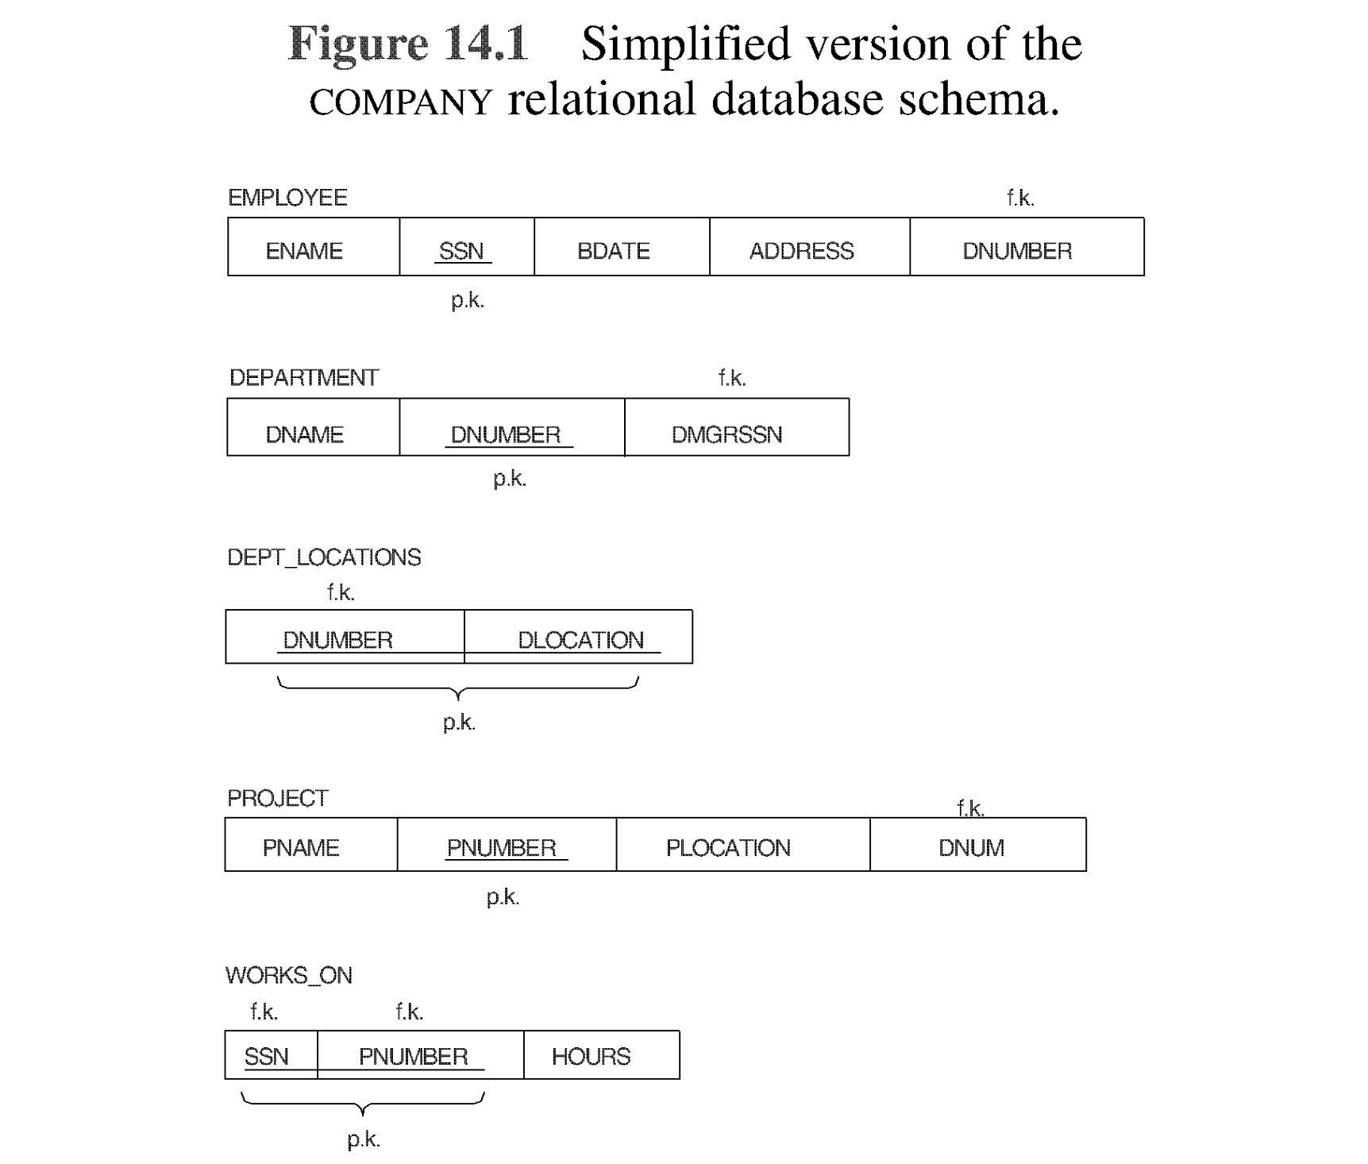

Slide 17
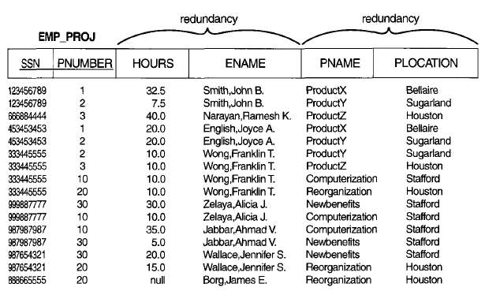
Informal Guidelines
Guideline 2 : Minimize the storage space used by the base relations and design a schema that does not suffer from the insertion, deletion and update anomalies.
Relations suffer from anomalies
Notes:
Minimize the storage space used by the base relations.

Slide 18
Informal Guidelines (contd.)
Guideline 3 : Relations should be designed such that their tuples will have as few NULL values as possible
Attributes that are NULL frequently could be placed in separate relations (with the primary key)
Reasons for nulls:
attribute not applicable or invalid
attribute value unknown (may exist)
value known to exist, but unavailable
Guideline 4 : Design schemas so that they can be joined with equality conditions on attributes that are primary key , foreign key (this will avoid spurious tuples generated).
Notes:
Fat relations, many of the attributes do not apply to all tuples in the relation: waste space, problems with understanding the meaning of attributes

Slide 19
Formal Process
Formal process for good relational schema:
To avoid the above mentioned issues in the relational schema, we can apply a formal process called Normalization
Normalization is based on functional dependencies

Slide 20
Functional Dependencies
FDs are used to specify formal measures of the "goodness" of relational designs
FDs and keys are used to define normal forms for relations

Slide 21
Functional dependency
A functional dependency, is a constraint between two sets of attributes
denoted by X → Y,
X functionally determines Y
Y is functionally dependent on X
where X and Y are sets of attributes in relation R, specifies the following constraint:
Let t₁ and t₂ be tuples of relation R for any given instance
Whenever t₁[X] = t₂[X] then t₁[Y] = t₂[Y]
where t_{i}[X] represents the values for X in tuple ti

Slide 22
Functional dependency
Describes the relationship between attributes in a relation.
If A and B are attributes of relation R, B is functionally dependent on A (denoted A → B), if each value of A is associated with exactly one value of B.
(A and B may each consist of one or more attributes)

Slide 23
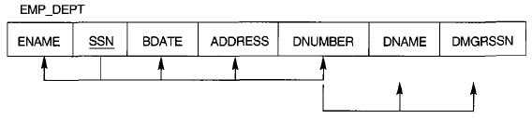
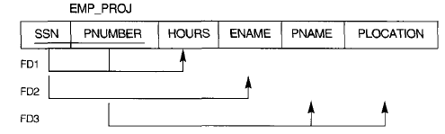
Functional dependency
(Ssn,Pnumber) -> Hours (SSN & PNUMBER detrmines hrs emp work on a project)
Ssn -> Ename
Pnumber -> (pname, plocation) (PNUMBER determines pname & location)

Slide 24
Functional dependency

Slide 25
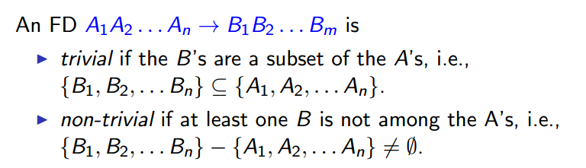
Functional dependency
Trivial :- staffNo, sName → sName
staffNo, sName → staffNo
NonTrivial :- staffNo, sName → salary

Slide 26
Functional dependency
Given a set of FDs F, we can infer additional FDs that hold whenever the FDs in F hold
Armstrong's inference rules:
IR1. (Reflexive) If Y subset-of X, then X → Y
IR2. (Augmentation) If X → Y, then XZ → YZ
(Notation: XZ stands for X U Z or {X, Z})
IR3. (Transitive) If X → Y and Y → Z, then X → Z
Additional inference rules that are useful:
(Decomposition) If X → YZ, then X → Y and X → Z
(Union) If X → Y and X → Z, then X → YZ
(Psuedotransitivity) If X → Y and WY → Z, then WX → Z

Slide 27
Functional dependency
Closure of a set F of FDs is the set F⁺ of all FDs that can be inferred from F
Closure of a set of attributes X with respect to F is the set X ⁺ of all attributes that are functionally determined by X
X ⁺ can be calculated by repeatedly applying IR1, IR2, IR3 using the FDs in F

Slide 28
Normalization
Key points:
Redundancy is based on functional dependencies
Therefore, normalization is based on functional dependencies
Therefore, relational database schema need to be refined
Schema Refinement Steps:
Determine Functional dependencies for relation
Find all keys in relation
Normalize the relation

Slide 29
Database basics - review
Review of some terms
Key: A key is a superkey with the additional property that removal of any attributes from the key will not satisfy the key condition (minimal set of attributes)
eg : Student-No
Superkey: Set of attributes S in relation R that can be used to identify each tuple uniquely.
eg : ( Student-No, name)

Slide 30
Database basics - review
Candidate Key: Each key of a relation is called a candidate key
Primary Key: A candidate key is chosen to be the primary key
Prime Attribute: an attribute which is a member of a candidate key
Nonprime Attribute: An attribute which is not prime

Slide 31
Stages of Normalization
There are many Normal Forms proposed to reduce redundancies
Unnormalised
(UDF)
Remove repeating groups
First normal form
(1NF)
Remove partial dependencies
Second normal form
(2NF)
Remove transitive dependencies
Third normal form
(3NF)
Remove remaining functional
dependency anomalies
Boyce-Codd normal
form (BCNF)

Slide 32
Un-normalized Normal Form (UNF)
A relation is un-normalized when it has not had any normalization rules applied to it, and it suffers from various anomalies

Slide 33
Normalization - 1st Normal Form
A relation R is in first normal form (1NF) if domains of all attributes in the relation are atomic (simple & indivisible).
Avoid multi valued & composite attributes
Remove repeating groups into a new relation
Steps from UNF to 1NF:
Remove the outermost repeating group and create a new relation
Add to this relation a copy of the PK of the original relation.
Name the new relation
Determine the PK of the new relation
Repeat steps until no more repeating groups.

Slide 34
Normalization - 1st Normal Form
For example:
DEPARTMENT (Dname,Dnumber, DMGRSSN, (DLocation))
Department is in UNF
Department relation not in 1NF
How to take into 1NF ?
DEPARTMENT
DNAME
DNUMBER
DMGRSSN
DLOCATIONS
Research
5
333445555
{Mathara, Kandy, Colombo}
Administration
4
987654321
{Malabe}
Headquarters
1
888665555
{Colombo}

Slide 35
Solution
: Create a separate DEPT_LOCATION relation with foreign key
DEPT_LOCATIONS
Remove the attribute DLOCTION and place it in a separate relation DEPT_LOCTIONS along with the primary key DNUMBER of DEPARTMENT.
The PK is the combination {DNUMBER, DLOCTION}
This decompose the non-INF relation into two INF relation.
DNUMBER
DLOCATIONS
1
Colombo
4
Malabe
5
Mathara
5
Kandy
5
Colombo
DEPARTMENT
DNAME
DNUMBER
DMGRSSN
Research
5
333445555
Administration
4
987654321
Headquarters
1
888665555

Slide 36
Full Functional Dependency
A functional dependency, X → Y is a full functional dependency if removal of any attribute A from X means that the dependency does not hold
(i.e. (X –{A}) → Y does not hold )
TEACH
STUDENT | COURSE | TEACHER | CAMPUS
Narayan | Database | ABC | Colombo
Smith | Database | XYZ | Malabe
Nalin | Operating Systems | Samantha | Colombo
Kamal | Operating Systems | ABC | Malabe
Janith | Database | ABC | Colombo
Ranil | Operating Systems | Samantha | Colombo
Saman | Operating Systems | ABC | Malabe
Ruwan | Database | XYZ | Malabe
{Teacher, Campus} → Course
Teacher does NOT determine course

Slide 37
Normalization – 2nd Normal Form
A relation R is in second normal form (2NF) if every nonprime attribute A in R is not partially dependent on any key of R
Remove partial functional dependencies into a new relation
Example: Not in 2NF
TEACHER | CAMPUS | COURSE | ADDRESS
Kapila | Colombo | Database | BoC Merchant Tower
Nuwan | Malabe | Database | New Kandy Road
Samantha | Colombo | Operating Systems | BoC Merchant Tower
Kapila | Malabe | Operating Systems | New Kandy Road
Partial dependency

Slide 38
Normalization – 2nd Normal Form
Steps from 1NF to 2NF:
Remove the attributes that are only partially functionally dependent on the composite key, and place them in a new relation.
Add to this relation a copy of the attribute(s) which are the determinants of these offending attributes. These will automatically become the primary key of this new relation.
Name the new relation
Rename the original relation

Slide 39
Normalization – 2nd Normal Form
Example: After normalized into 2NF
TEACHER | CAMPUS | COURSE
Kapila | Metro | Database
Nuwan | Malabe | Database
Samantha | Metro | Operating Systems
Kapila | Malabe | Operating Systems
CAMPUS | ADDRESS
Metro | BoC Merchant Tower
Malabe | Malabe Campus

Slide 40
EMP_PROJ
SSN | PNUM | HOURS | ENAME | PNAME | LOC
FD1
FD2
FD3
SSN | PNUM | HOURS
FD1
FD3
FD2
SSN | ENAME
PNUM | PNAME | PLOC

Slide 41
Normalization – 3rd Normal Form
A relation R is in 3rd normal form (3NF) if every
R is in 2NF, and
No nonprime attribute is transitively dependent on any key
Remove transitive dependencies into a new relation

Slide 42
Normalization – 3rd Normal Form
Steps from 2NF to 3NF:
Remove the offending attributes that are transitively dependent on non-key attribute(s), and place them in a new relation.
Add to this relation a copy of the attribute(s) which are the determinants of these offending attributes. These will automatically become the primary key of this new relation.
Name the new relation.
Rename the original relation.

Slide 43
Normalization – 3rd NormalForm
FD1
FD2
ENAME | SSN | BDATE | ADD | DNUM
DNUM | DNAME | DMGR

Slide 44
Boyce-Codd Normal Form
A relation schema is in Boyce-Codd Normal Form
If every nontrivial functional dependency X→A hold in R, then X is a superkey of R
A relation is in BCNF if and only if, every determinant is a candidate key
Every relation in BCNF is also in 3NF
A relation is in BCNF, if and only if, every determinant is a candidate key

Slide 45
Normalization –(BCNF)
Keys: PropertyID, (County_Name, Lot#)
PROPERTY_ID | COUNTY_NAME | LOT# | AREA | PRICE | TAX_RATE
FD1
FD2
FD3
FD4
FD5

Slide 46
Normalization –BCNF
(a)
LOTS1A
PROPERTY ID#
COUNTY_NAME
LOT#
AREA
FD1
FD2
FD5
BCNF Normalization
LOTS1AX
LOTS1AY
PROPERTY ID#
AREA
LOT#
AREA
COUNTY_NAME

Slide 47
Normalization
1NF, 2NF, 3NF & BCNF guarantee to preserve lossless join property
However, BCNF does not guarantee to preserve dependency preserving property

Slide 48
De-normalization
Sometime for performance reasons, database designer may leave the relation in a lower normal form. This process is known as de-normalization.

Slide 49
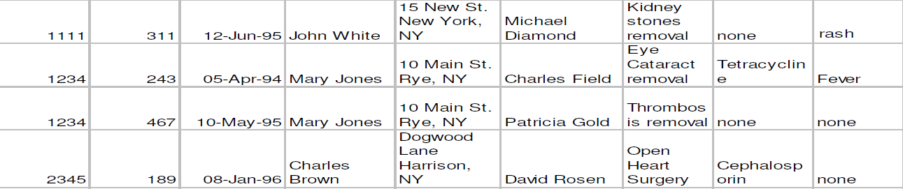
Exercise 1
FD1
Patient# | Surgeon# | Surgery_Date | Patient_Name | Patient_Addr | Surgeon_Name | Surgery | Drug_Admin | Side_Effects
FD2
FD3
FD4
1. What normal form is the relation in?
2. If it is not in 3NF, convert it to 3NF. Explain your answer.

Slide 50
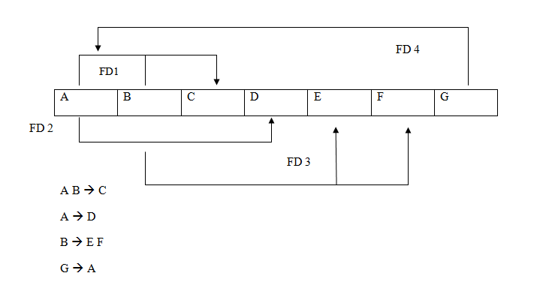
Exercise 2
Consider the following relational schema for R:
R(A, B,C,D,E,F,G)
AB is the primary key in the relation. Assume that the following dependencies exist:
1. What normal form is the relation in?
2. If R is not in BCNF, convert it to BCNF. Explain your answer.

Slide 51
End of Lecture 07
Questions ?

